Slide 1
Logistics Optimization: Loading Trends, Operational Hotspots and Performance Analysis Presentation
By Shramana Sinha

Slide 2
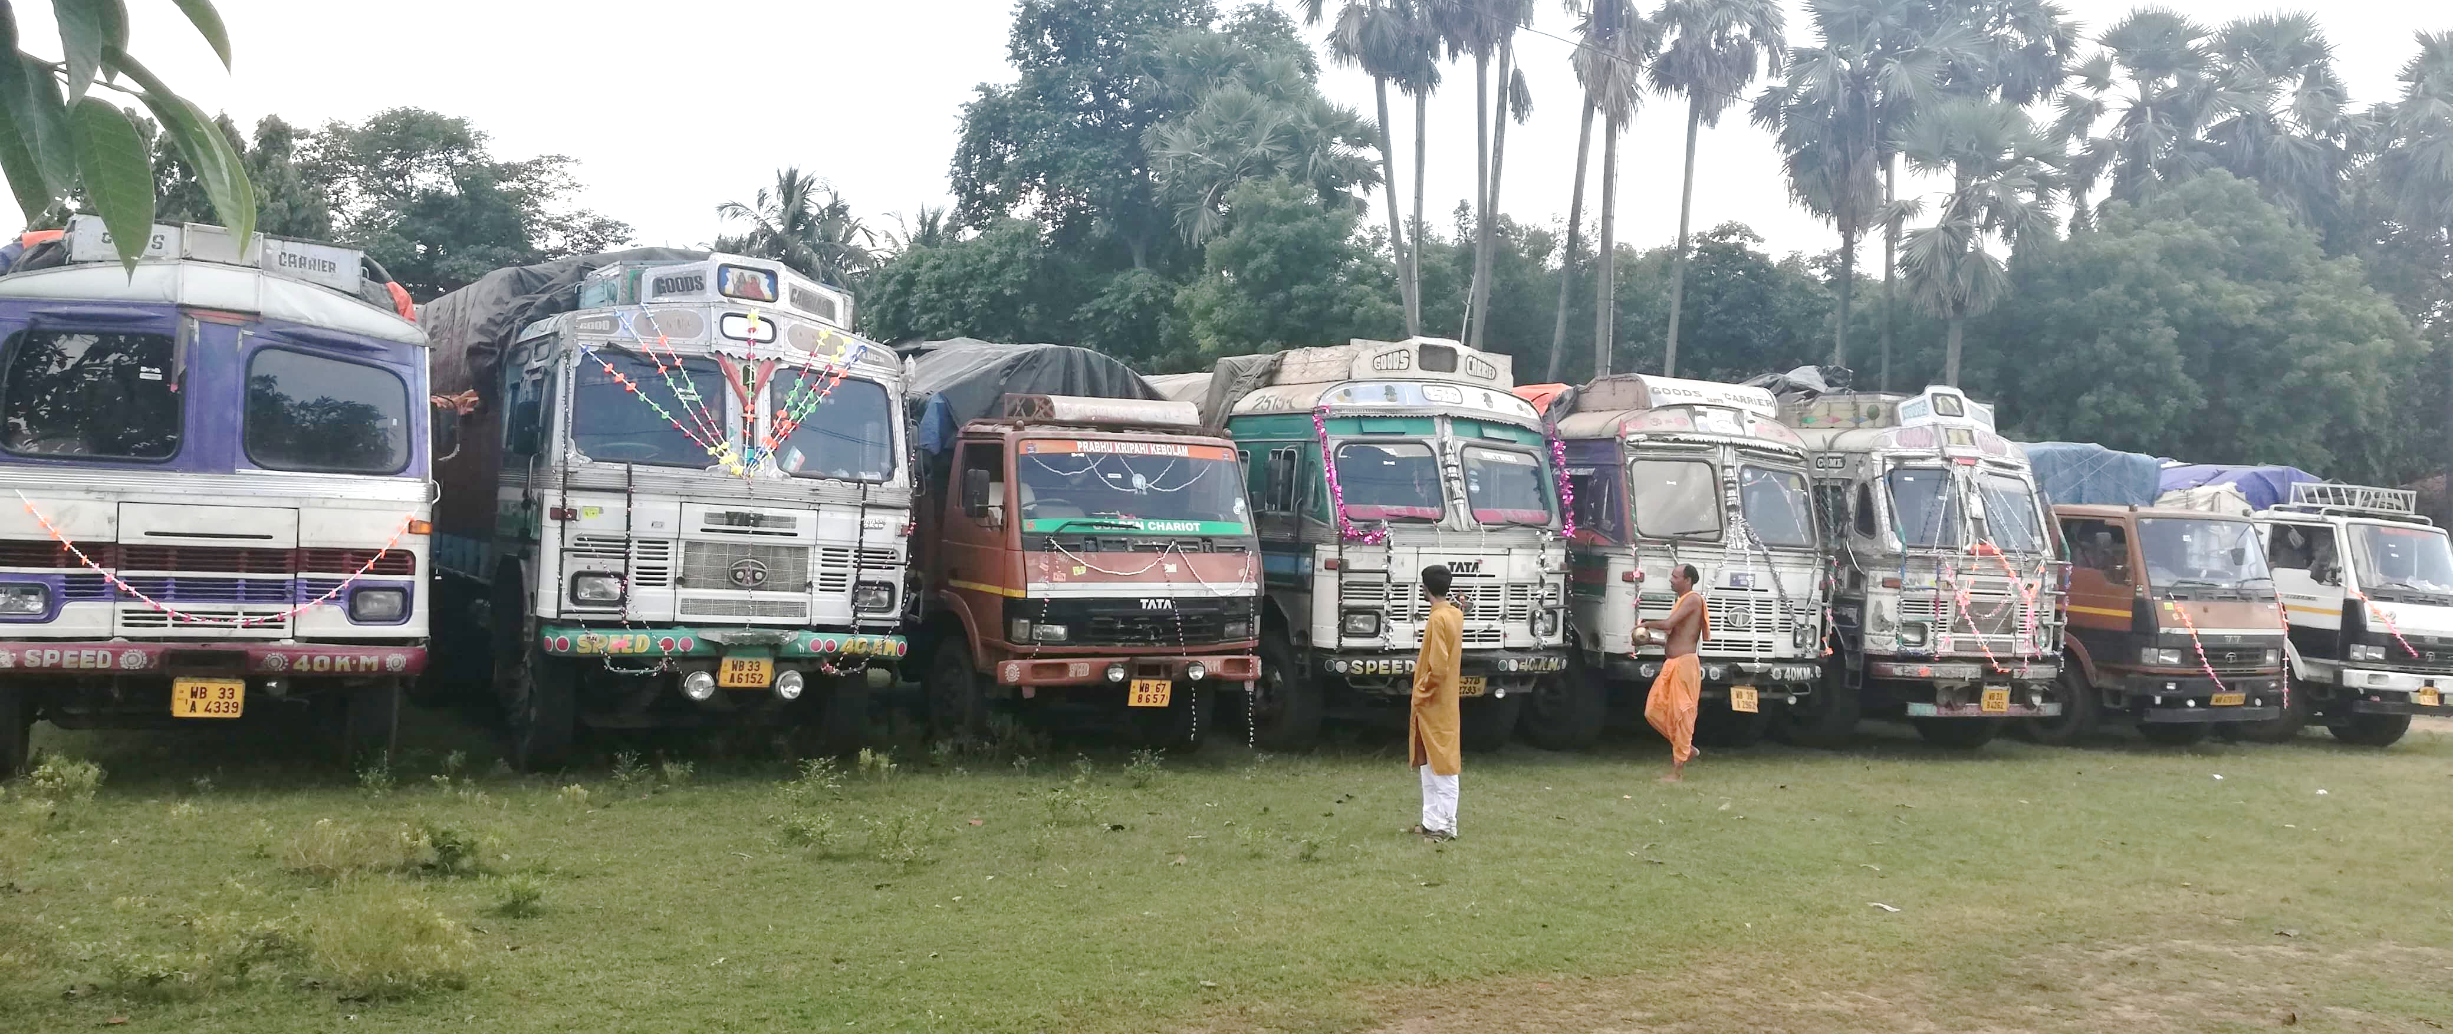
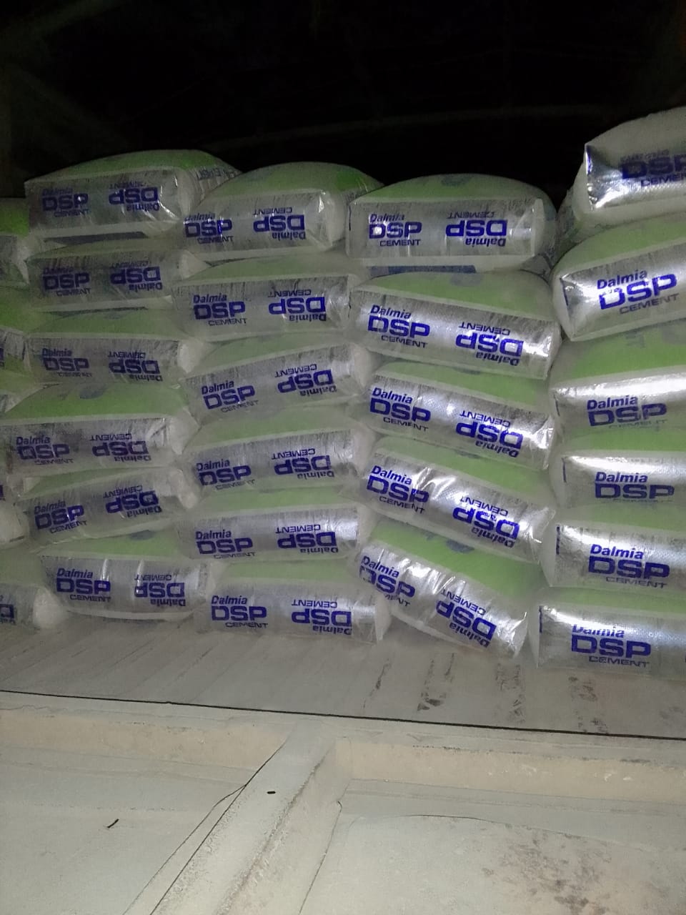
Project analysis slide 2
Organizational Background
Aakash Logistics, a transport and logistics firm based in Bankura, West Bengal, was established in 2017 by Adrish Kanti Sinha.
It is a transport partner of OCL-Dalmia, Medinipur, West Bengal. It is responsible for delivering cement to the dealers as per OCL’s demand.
It operates mainly within Bankura, Medinipur, and Paschim Burdwan with a fleet of twelve owner-operated trucks.

Slide 3
Project analysis slide 3
Problems
1. Ensuring timely arrangement of third-party trucks during high demand periods
2. Improving the efficiency of backhaul trips coordination
3. Increasing the driver retention rate
It faces challenges in securing return freights in the vicinity of the unloading locations. On average, backhaul trips earn 10-30% less than front hauls. However when trips involve empty miles, they do not contribute to revenue generation. The firm is currently only able to make about 68% of all trips as roundtrip hauls.
The firm has a driver retention rate of 50%, significantly lower than the industry standard of 86.3%.. This scenario is further exacerbated due to drivers taking uninformed leaves and day-offs.
It lacks a system to forecast high demand periods and plan for adequate resources thus facing difficulty in arranging third-party trucks during high demand periods and is only able to fulfill 75-80% of demand.

Slide 4
Project analysis slide 4
Data Collection and Preprocessing
Collection of 11 spreadsheets
containing ledger entries from
1st January to 20th November 2023.
Addition of columns to identify the trip type, ownership, revenue and profit per trip based on the dataset.
Dataset consists 1336 data points and 15 fields which contains details about all head haul trips from OCL.
Consolidation of the data into a single spreadsheet.
Removal of irrelevant fields and incomplete and inconsistent data points.
Data Collection
Data Cleaning
Data Preprocessing
End Result

Slide 5
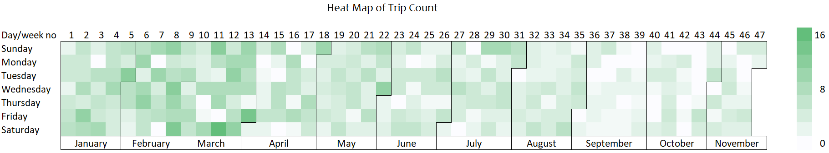
Project analysis slide 5
Loading Trend Analysis
Week 1-13
September - November
End of the month (27th – 31st)
6 Trips/Day
2 Trips/Day
5 Trips/Day
This period registered the highest trip count due to OCL’s need to meet its annual targets, leading to an increase in shipment orders.
Even when the demand exists, trip count during this period is low due to driver unavailability. This is even lower than the monsoon average of 4 trips per day.
On average which is 1.37 times higher than the rest of the month and 1.68 times higher than the month beginning (1st to 4th ).

Slide 6
Project analysis slide 10
Operational Hotspots Analysis
Asansol
380 Trips
Which makes up 39% of all the trips done by the owner’s trucks. 90% of those trips are round haul.
Bankura
295 Trips
Which makes up 30% of all the trips done by the owner’s trucks with 49% of those being round haul.
The firm prioritizes unloading in Asansol most of the time, driven by its higher profit margin and the highest revenue per ton. Bankura serves as the second option for unloading.

Slide 7
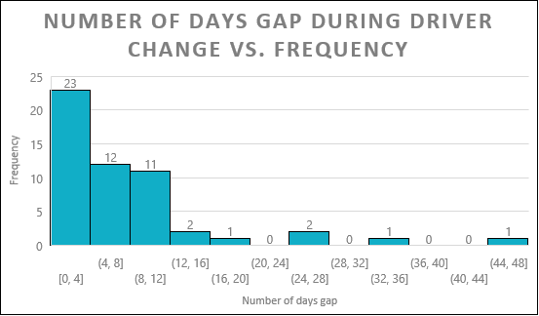
Project analysis slide 6
Performance Analysis
Trucks numbered 3761 and 0136 successfully met their respective targets for the period under consideration.
Trucks 1066 and 3747 were notably close to achieving their targets.
Trucks 2793 and 2962 exhibited the lowest trip count.
While the number of trips is largely dependent on demand, it is also influenced by factors such as the driver’s efficiency and the idling time of the truck.
Approximately 43% of the time, the duration for driver replacement was a reasonable 0-4 days.
For the remaining 57% of the instances, the replacement process extended to 5 days or more.
There were 2 instances where the replacement process exceeded 30 days.
The firm’s driver retention rate is currently at 50%. It is hard to retain them due to several reasons like better salary offered by competitors, not meeting the expected performance benchmarks, etc.

Slide 8
Project analysis slide 8
Recommendations
1. Timely arrangement of third-party trucks
2. Backhaul trips coordination improvement
3. Driver retention rate enhancement
Annual Planning
Preservation of Asansol’s backhaul trip coordination
Fixed Holiday System
During the peak demand period, specifically January to March (1st to 13th week of the year), advanced planning for procurement of third party trucks is crucial. This planning can ideally be initiated in December.
The firm could maintain a standby fleet of 3-4 trucks at the beginning of each month. The remaining drivers could then be provided with a rotational holiday schedule.
Asansol, a crucial location for the firm, has demonstrated success in coordinating backhaul trips without establishing any backhaul transport partnerships. This effective strategy should be sustained, with Asansol continuing as a primary focus in the firm’s operations.
Performance-based Incentives
Monthly Planning
It could introduce yearly incentives and recognition for the highest-performing drivers, particularly those who complete the most trips.
The end of each month (27th - 31st) typically witnesses a surge in demand. To cater to this increased demand, the engagement of third-party trucks can be planned a week in advance. This planning should be aligned with the average monthly demand.
Improvements for Bankura and Bishnupur
Formal Leave Process
The owner should consider establishing backhaul transport partnerships with the local industries in Bankura.
Establishing a formal process for leave applications can ensure smooth operations during driver absences. If a driver takes leave, they could be asked to provide a temporary replacement driver.

Slide 9
Thank You

